Slide 1
NWDS and IFlows

Slide 2
Table of contents
NWDS
1
IFLOWS
2

Slide 3
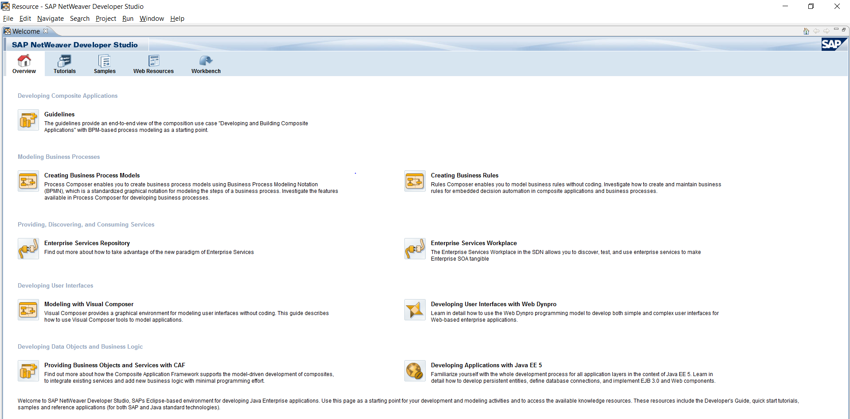
1. NWDS
Netweaver Developer Studio (NWDS) is an eclipse-based tool which helps to create Iflows, business processes, rules, create java mappings and it is used to create several Java, xml, and composite applications.

Slide 4
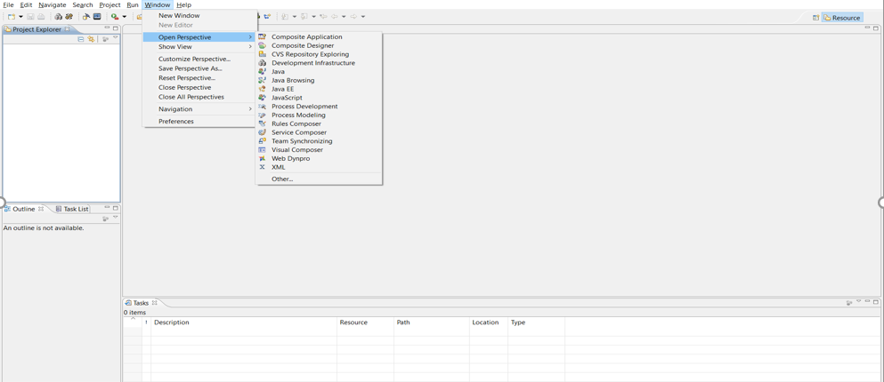
NWDS – different perspectives

Slide 5
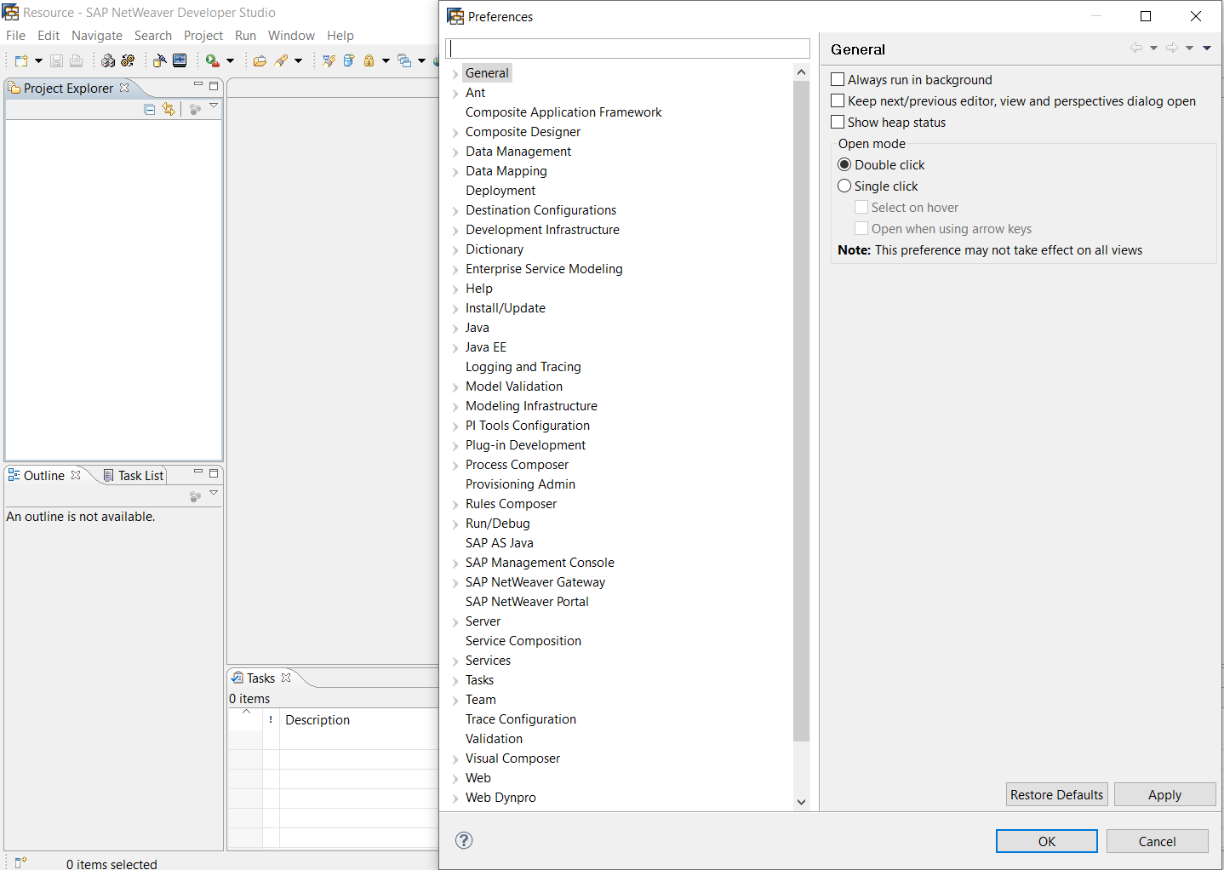
NWDS – Preferences

Slide 6
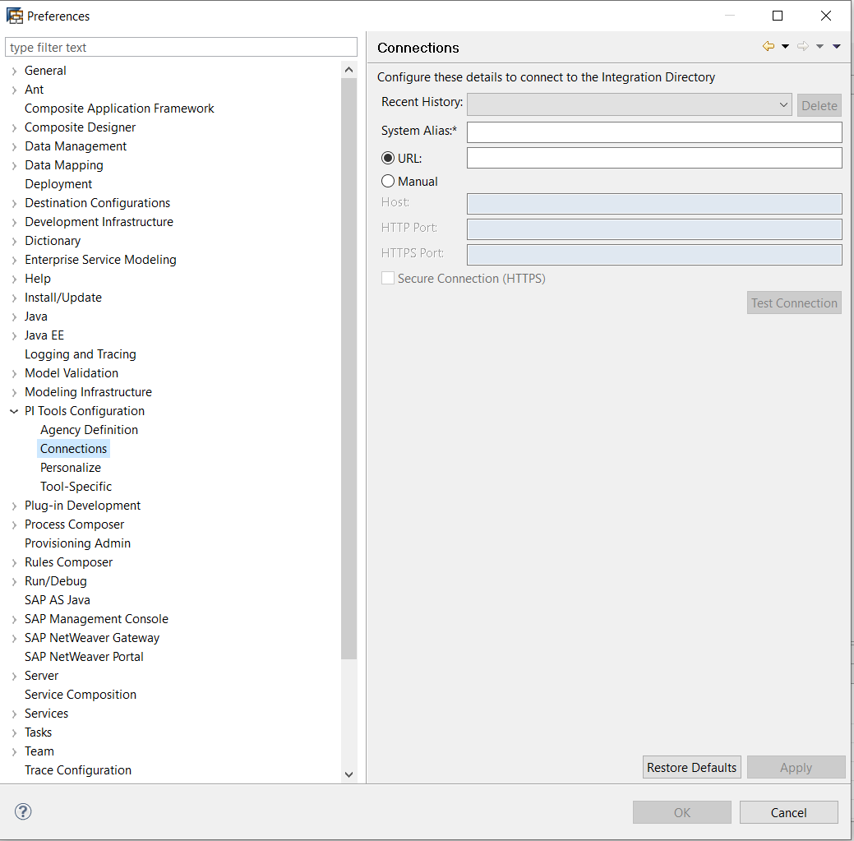
NWDS – PI Tools configuration

Slide 7
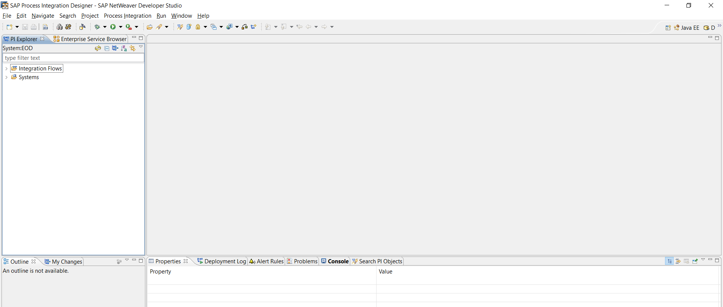
NWDS – PI perspective

Slide 8
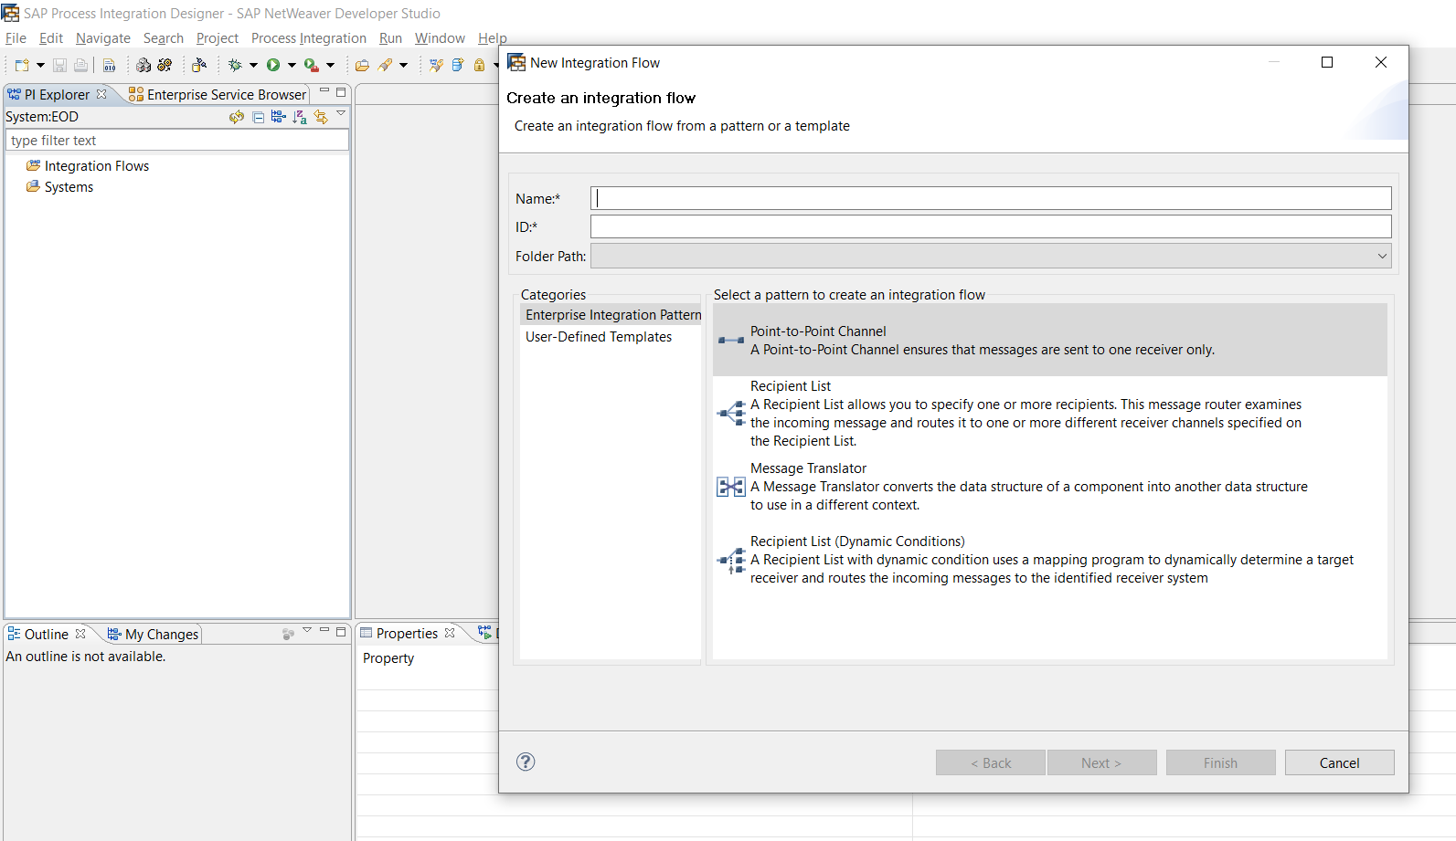
2. IFLOWS
IFLOWS is Integration flow, configuration objects which is based on bpm notation. A flow from sender to receiver with configuration of business systems/components, interfaces via mapping objects.

Slide 9
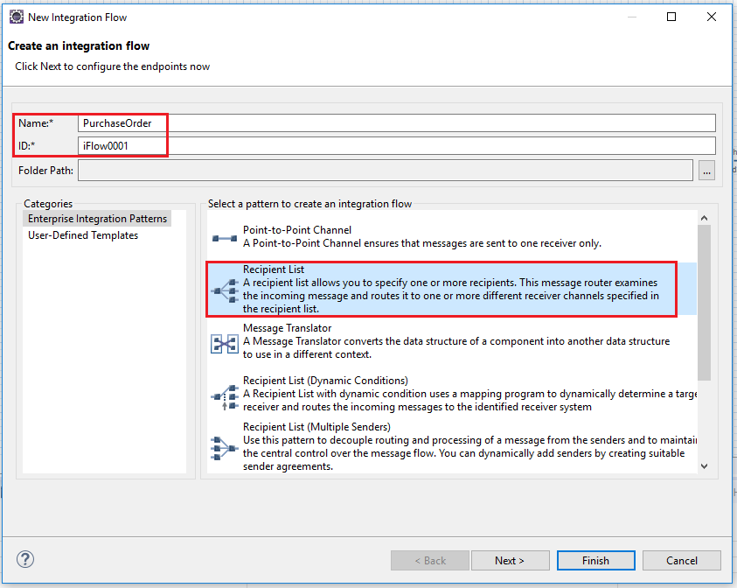
IFLOWS – Iflows can be created based on the Integration Patterns

Slide 10
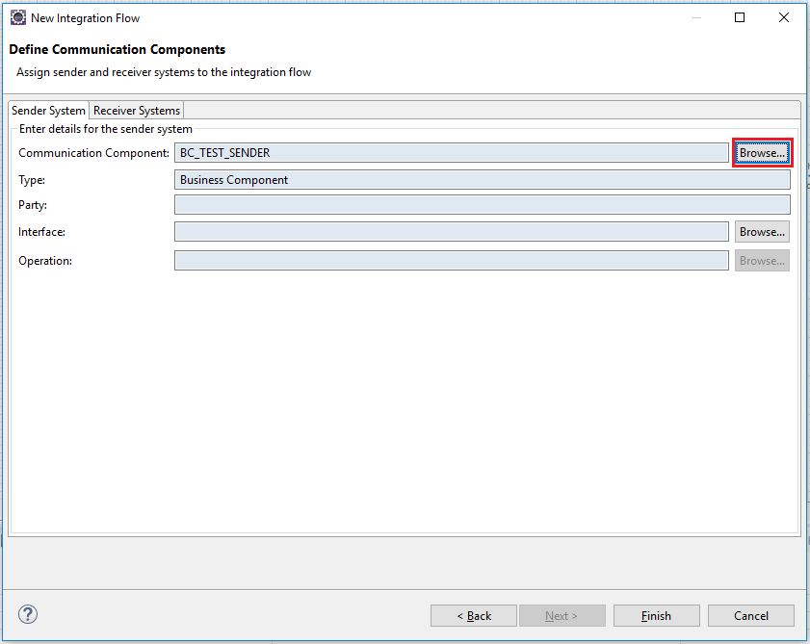
IFLOWS – contd.

Slide 11
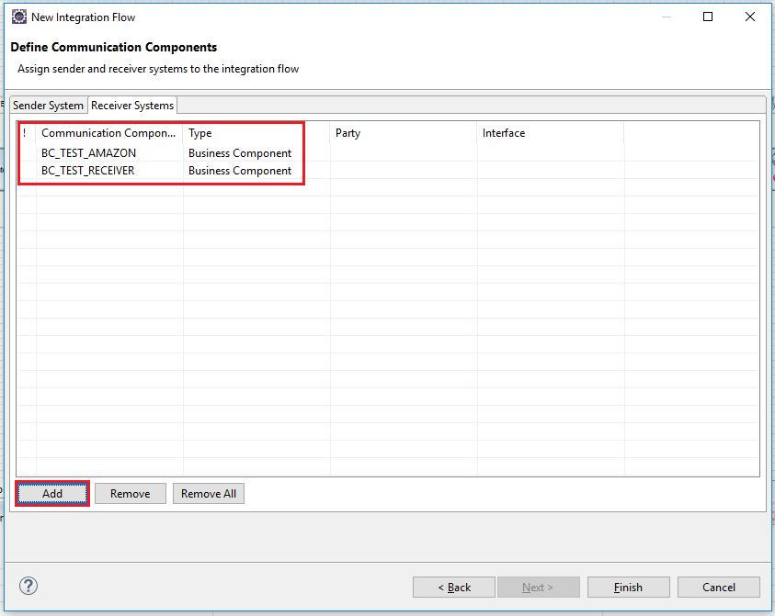
IFLOWS – contd.

Slide 12
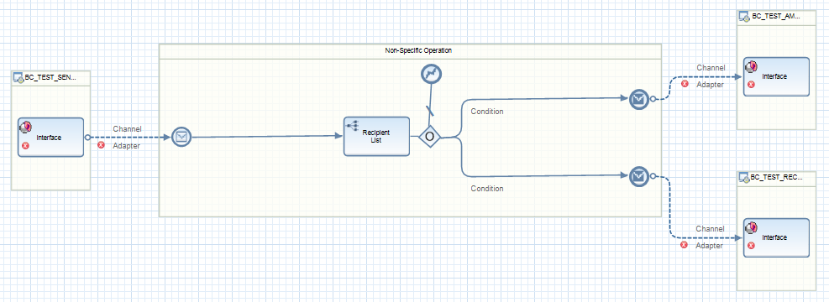
IFLOWS – contd.

Slide 13
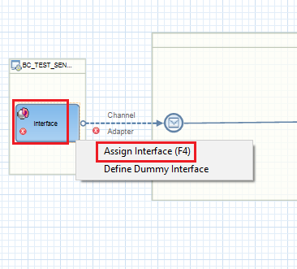
IFLOWS – Assign service interfaces, contd.

Slide 14
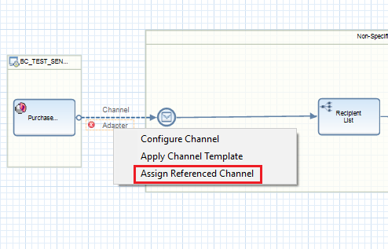
IFLOWS – Assign Communication Channels , contd.

Slide 15
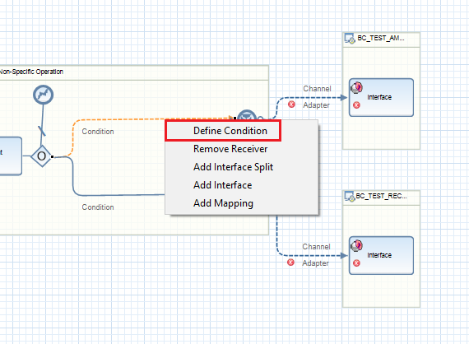
IFLOWS – Define the receiver rules, contd.

Slide 16
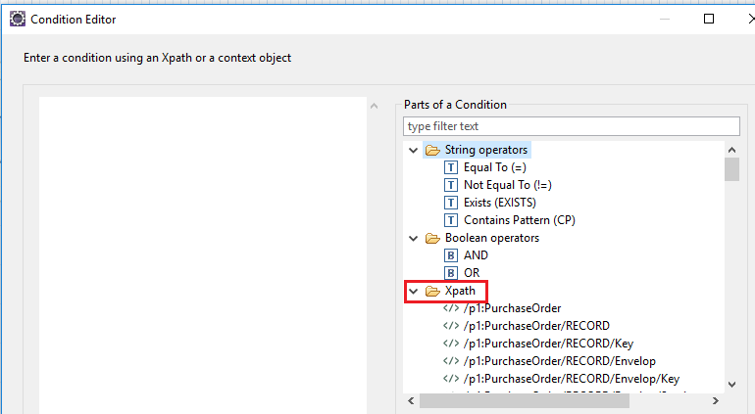
IFLOWS – Define the conditions, condition editor

Slide 17
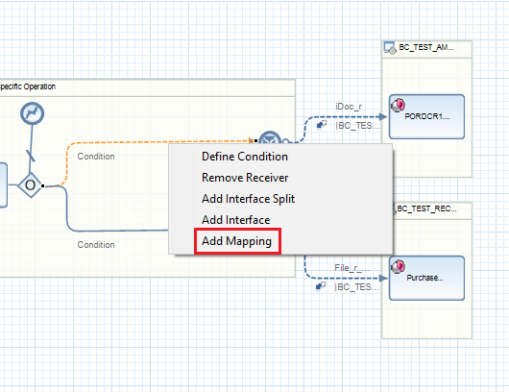
IFLOWS – Adding Mapping to iflow

Slide 18
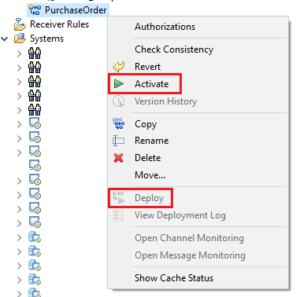
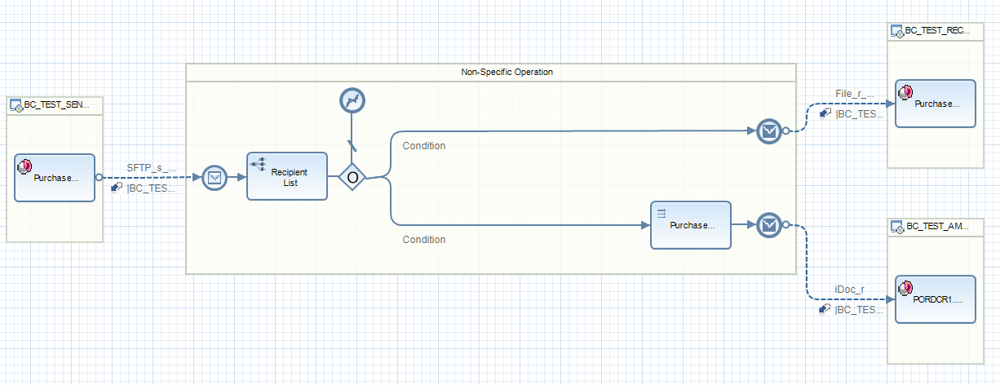
IFLOWS – Activating and Deploying the iflow

Slide 19
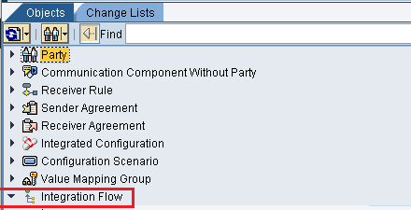
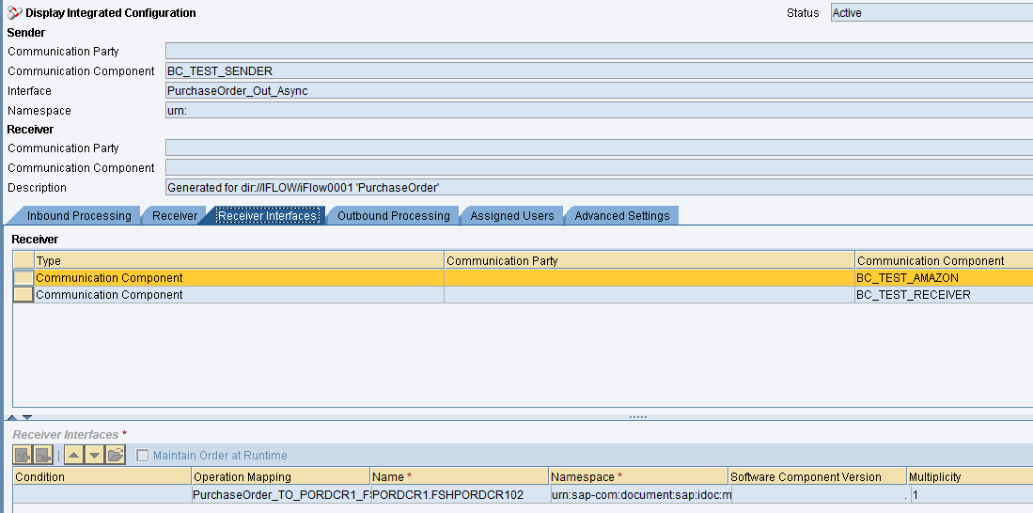
IFLOWS – Checking the deployed iflow in ID

